Slide 1
Computer Networks
Link Layer Services

Slide 2
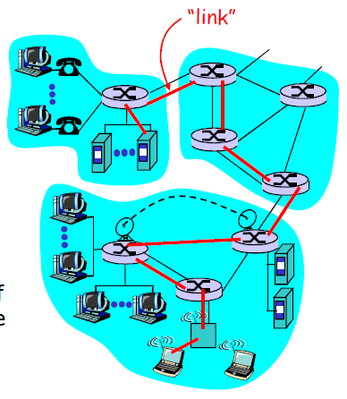
Link Layer: Introduction
Some terminology:
hosts and routers are nodes
communication channels that connect adjacent nodes along communication path are links
  wired links
  wireless links
  LANs
layer-2 packet is a frame, encapsulates datagram
data-link layer has responsibility of transferring datagram from one node to adjacent node over a link

Slide 3
Link layer: context
Mail analogy
Transport layer: envelops that contain the letters
Network: post offices and the address on the envelope
Link layer: the transportation service between each post office

Slide 4
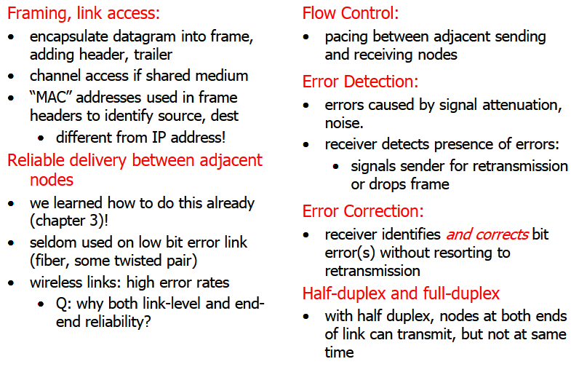
Link Layer Services

Slide 5
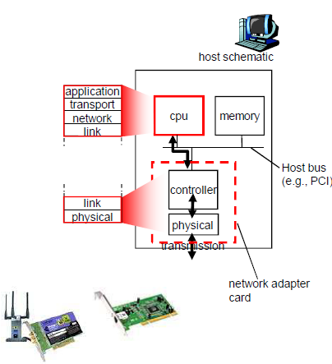
Where Is the Link Layer Implemented?
in each and every host
link layer implemented in “adaptor” (aka network interface card NIC)
Ethernet card, PCMCI card, 802.11 card
implements link, physical layer
attaches into host’s system buses
combination of hardware, software, firmware

Slide 6
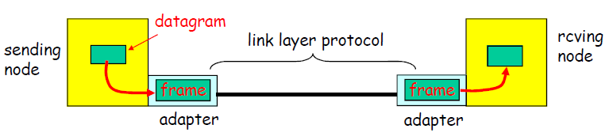
Adaptors Communicating
sending side:
  encapsulates datagram in a frame
  adds error checking bits, rdt, flow control, etc.
receiving side
  looks for errors, rdt, flow control, etc
  extracts datagram, passes to rcving node
adapter is semi-autonomous
link & physical layers

Slide 7
Multiple Access Links and Protocols
Two types of “links”:
point-to-point
  PPP for dial-up access
  point-to-point link between Ethernet switch and host
broadcast (shared wire or medium)
  traditional Ethernet
  upstream HFC
  802.11 wireless LAN

Slide 8
Multiple Access protocols
single shared broadcast channel
two or more simultaneous transmissions by nodes: interference
  collision if node receives two or more signals at the same time
multiple access protocol
distributed algorithm that determines how nodes share channel, i.e., determine when node can transmit
communication about channel sharing must use channel itself!
  no out-of-band channel for coordination

Slide 9
Multiple Access protocols
Ideal Multiple Access Protocol
Broadcast channel of rate R bps
1. When one node wants to transmit, it can send at rate R.
2. When M nodes want to transmit, each can send at average rate R/M
3. Fully decentralized:
    no special node to coordinate transmissions
    no synchronization of clocks, slots
4. Simple

Slide 10
MAC Protocols
Three broad classes:
Channel Partitioning
  divide channel into smaller “pieces” (time slots, frequency, code)
  allocate piece to node for exclusive use
Random Access
  channel not divided, allow collisions
  “recover” from collisions
“Taking turns”
  Nodes take turns, but nodes with more to send can take longer turns

Slide 11

Channel Partitioning MAC protocols: TDMA
TDMA: time division multiple access
access to channel in "rounds"
each station gets fixed length slot (length = pkt trans time) in each round
unused slots go idle – drawback!
example: 6-station LAN, 1,3,4 have pkt, slots 2,5,6 idle

Slide 12
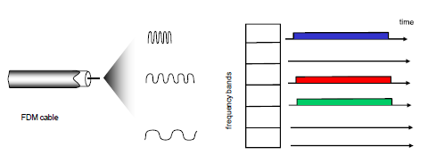
Channel Partitioning MAC protocols: FDMA
FDMA: frequency division multiple access
channel spectrum divided into frequency bands
each station assigned fixed frequency band
unused transmission time in frequency bands go idle – drawback!
example: 6-station LAN, 1,3,4 have pkt, frequency bands 2,5,6 idle

Slide 13
Random Access Protocols
When node has packet to send
transmit at full channel data rate R.
no a priori coordination among nodes
two or more transmitting nodes ➜ “collision”,
Random access MAC protocol specifies:
how to detect collisions
how to recover from collisions (e.g., via delayed retransmissions)
Examples of random access MAC protocols:
slotted ALOHA
ALOHA
CSMA, CSMA/CD, CSMA/CA

Slide 14
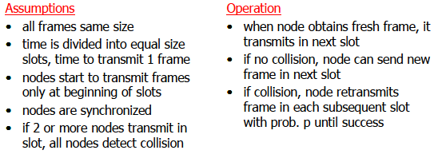
Slotted ALOHA

Slide 15
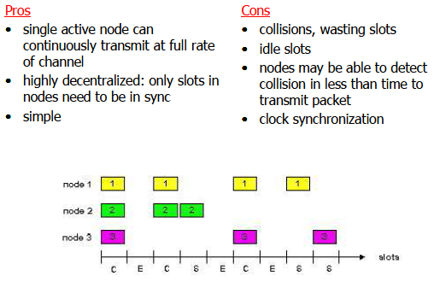
Slotted ALOHA

Slide 16
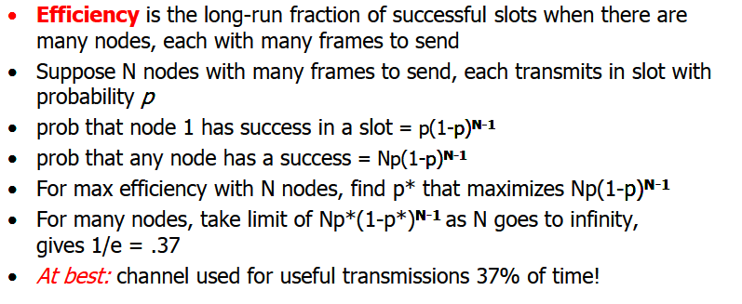
Slotted Aloha efficiency

Slide 17
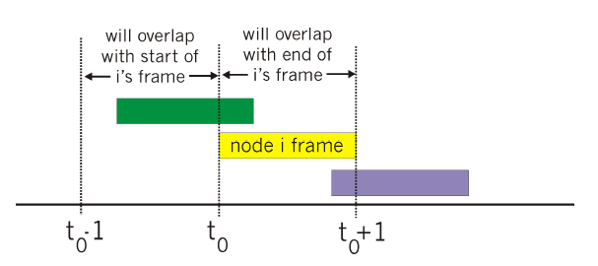
Pure (unslotted) ALOHA
unslotted Aloha: simpler, no synchronization
when frame first arrives
  transmit immediately
collision probability increases:
  frame sent at t0 collides with other frames sent in [t0-1,t0+1]

Slide 18
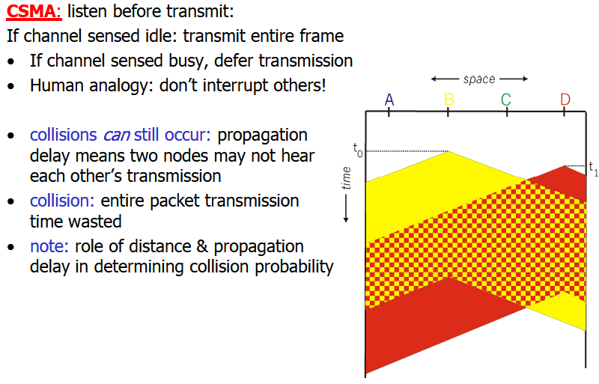
CSMA (Carrier Sense Multiple Access)

Slide 19
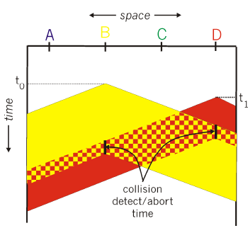
CSMA (Carrier Sense Multiple Access)
CSMA/CD: carrier sensing, deferral as in CSMA
  collisions detected within short time
  colliding transmissions aborted, reducing channel wastage
collision detection:
  easy in wired LANs: measure signal
strengths, compare transmitted,
received signals
  difficult in wireless LANs:
receiver shut off while
transmitting

Slide 20
Channel partition Vs Random access
channel partitioning MAC protocols:
share channel efficiently and fairly at high load
inefficient at low load: delay in channel access, 1/N bandwidth allocated even if only 1 active node!
Random access MAC protocols
efficient at low load: single node can fully utilize channel
high load: collision overhead
“taking turns” protocols
look for best of both worlds!

Slide 21
Interactive Animations
CSMA/CD
Notes:
https://media.pearsoncmg.com/aw/ecs_kurose_compnetwork_7/cw/content/interactiveanimations/csma-cd/index.html

Slide 22
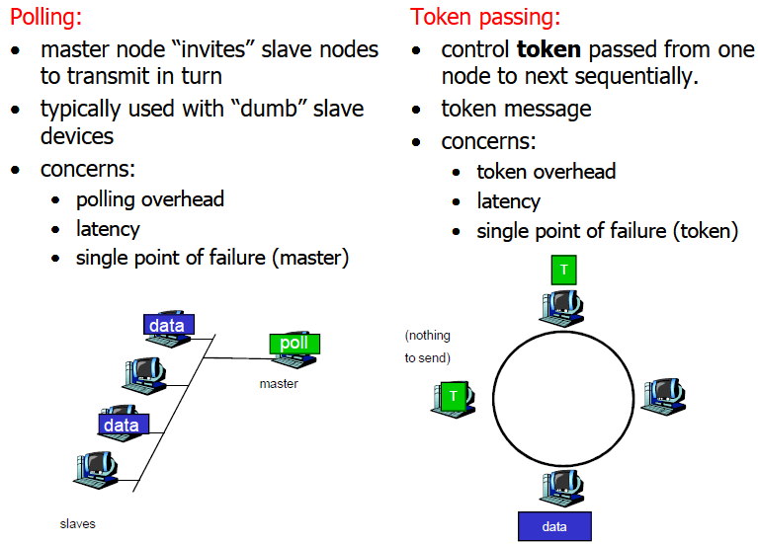
“Taking Turns” MAC protocols

Slide 23
Summary of MAC protocols
What do you do with a shared media?
Channel Partitioning, by time, frequency or code
  Time Division, Frequency Division
Random partitioning (dynamic),
  ALOHA, S-ALOHA, CSMA, CSMA/CD
  carrier sensing: easy in some technologies (wire), hard in others (wireless)
  CSMA/CD used in Ethernet
  CSMA used in 802.11
Taking Turns
  polling from a central site, token passing

